Slide 1
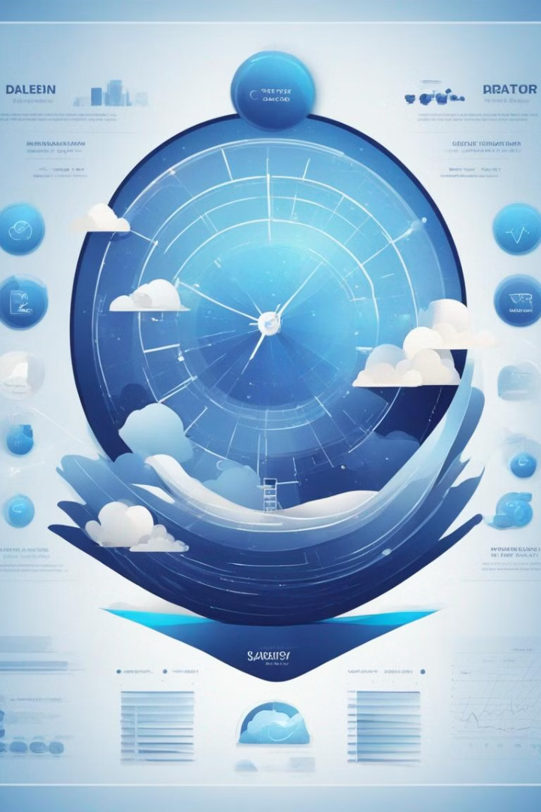

Sleep, Health, and Lifestyle Predictor Website
A sleep, health, and lifestyle predictor website utilizes data analysis, algorithms, and user input to provide personalized insights and predictions related to sleep quality, overall health, and lifestyle habits.

Slide 2

INTRODUCTION
The website is designed to predict and provide insights into sleep quality, overall health, and lifestyle habits.
The website aims to empower users to make informed decisions about their health and lifestyle habits, leading to improved well-being and quality of life.
Utilizes data analysis, algorithms, and user input to generate personalized predictions and recommendations.

Slide 3
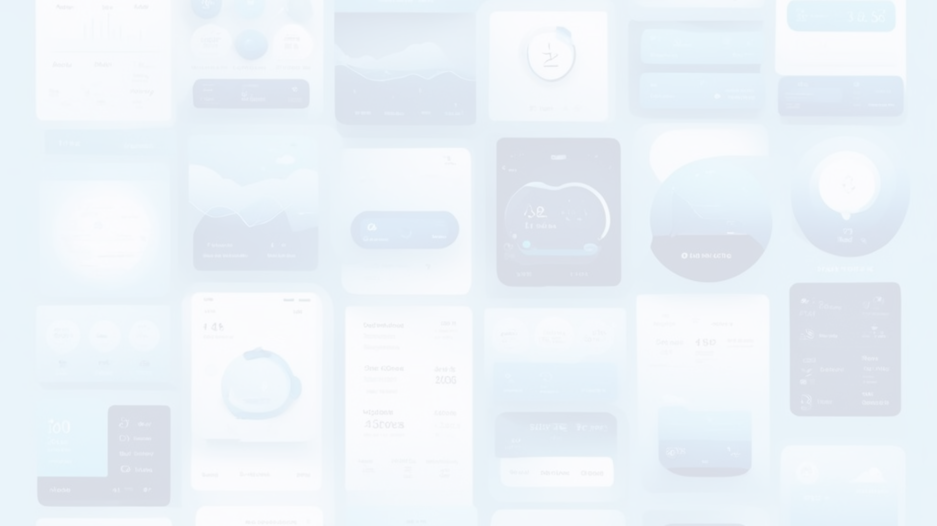
INPUT DATAS
1
Sleep Patterns
Users input information about their sleep patterns, including duration and quality.
2
Diet & Exercise
Information such as diet, exercise routines, and stress levels is provided by the users.
3
Stress levels & other Relevant Factors
Other relevant factors impacting health and lifestyle are also included in the input.

Slide 4

PREDICTIONS & RECOMMENDATIONS
1
Sleep Quality
2
Health Conditions
The website generates predictions or recommendations regarding sleep quality based on the input data.
Risk of certain health conditions and optimal exercise routines are predicted.
3
Dietary Recommendations
4
Stress Management
Users receive dietary recommendations based on the processed data.
Strategies for stress management are recommended to the users.

Slide 5

EXISTING SYSTEM
Numerous sleep tracking devices and applications are accessible on the internet. However, most of them focus on monitoring sleep duration and providing an overall assessment of sleep quality. Many sleep trackers primarily focus on total sleep time without delving into the different sleep disorders and sleep quality

Slide 6

PROPOSED SYSTEM
This comprehensive project encompasses the meticulous analysis of a diverse sleep, health and lifestyle dataset. Leveraging machine learning techniques, we have developed an innovative application capable of predicting stress levels. Beyond stress prediction, the application tailors personalized sleep schedules based on user-provided information, thereby promoting overall well-being, and fostering healthier sleep habits

Slide 7

PROJECT REQUIREMENTS
LANGUAGES
FRONTEND
HTML
CSS
JS
JINJA
BACKEND
PYTHON
FRAMEWORK
DJANGO
Django is a high-level Python web framework that encourages rapid development and clean, pragmatic design. Django follows the Model-View-Controller (MVC) architectural pattern, with models representing the data structure, views handling user interface logic, and templates managing the presentation layer

Slide 8

PROJECT REQUIREMENTS
HARDWARE REQUIREMENTS
PC or Laptop
Processor i5 or more
4GB RAM
SOFTWARE REQUIREMENTS
OS: Windows 10 or 11
IDE: VS code
DATABASE: PostgreSQL

Slide 9
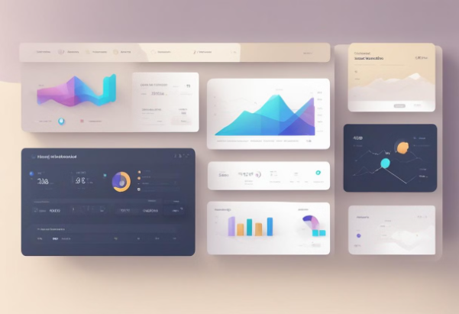

MODULE DESCRIPTION
ADMIN
SLEEPWELL
This module encompasses all administrative functions, superuser activities, and admin sites, along with the associated database tables essential for the seamless operation of a website.
This is the core module which contains basic and overall functions.
Some important files its contains are settings.py - which contains all the settings for the project Urls.py - which contains the main routing urls
Django automatically generates this module during the project creation process.
the module incorporates numerous built-in functions provided by Django to facilitate rapid, straightforward, and efficient development and utilization of the website.

Slide 10


MODULE DESCRIPTION
MAINAPP
HEALTHPROFILEAPP
This module contains mainly 2 pages HomePage About Page views.py and urls.py contain the code responsible for rendering the Homepage (including the index page) and the About page
The module primarily manages user profiles and health records, encompassing functionalities related to sign-in, sign-up, sign-out, and dashboard interactions.urls.py` and views.py files handle routing and processing of requests pertaining to authentication and user interface navigationThis has forms.py file which automatically generate the HTML Forms for us.Models.py file automatically create Database tables and Models

Slide 11
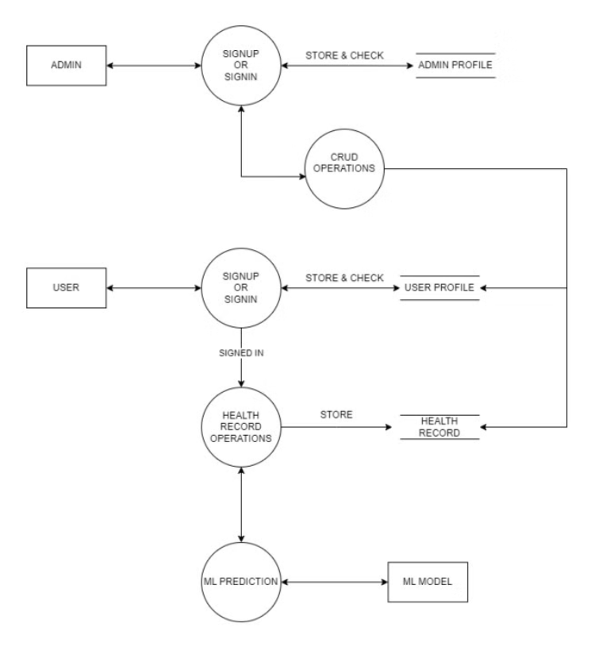
WORKFLOW (DFD)

Slide 12




CONCLUSION
Sleep, health, and lifestyle predictor websites represent a significant advancement in the realm of digital health platforms.
By leveraging technology to analyze user data and provide personalized insights, these platforms offer valuable guidance for individuals striving to enhance their overall well-being.
With their evidence-based predictions and recommendations, these websites empower users to take proactive steps towards improving their health and lifestyle habits.

Slide 13

FUTURE SCOPE
The future holds immense potential for the development and expansion of sleep, health, and lifestyle predictor websites.
Integration of Wearable Technology
Collaboration with Healthcare Providers
Enhanced User Experience
Expansion of Predictive Capabilities

Slide 14

REFERENCES
Understanding Blood Pressure Readings | American Heart Association
BMI Calculator
Sleep Foundation | Better Sleep for a Better You
Machine Learning in Healthcare - PMC (nih.gov)
Digital health data-driven approaches to understand human behavior | Neuropsychopharmacology (nature.com)

Slide 15

THANKYOU…

